Slide 1
Let's talk...
ABOUT
PRIDE
What is Pride?
Where do Pride celebrations take place?
How can I find out more about this?
LET'S GET TALKING ABOUT DIFFERENCE
DUALFREQUENCY.CO.UK

Slide 2
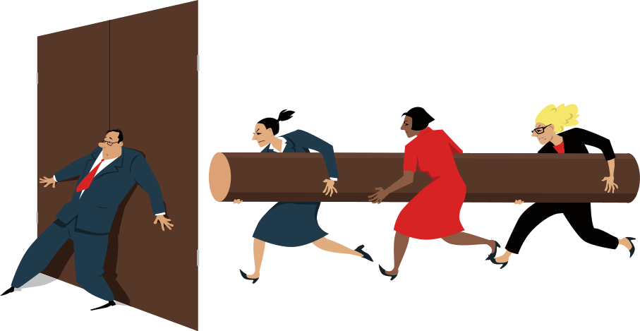
Let's talk...
ABOUT
DISCRIMINATION
Who faces discrimination?
What should I do if I see or hear
that somebody is being discriminated against?
Are there laws about discrimination?
LET'S GET TALKING ABOUT DIFFERENCE
DUALFREQUENCY.CO.UK

Slide 3
Let's talk...
ABOUT
ANTI-RACISM
What does it mean to be an anti-racist?
How can I safely challenge racism?
Am I privileged?
LET'S GET TALKING ABOUT DIFFERENCE
DUALFREQUENCY.CO.UK

Slide 4
Let's talk...
ABOUT
THE EQUALITY ACT
When did it come into force?
Who does it protect?
What is a protected characteristic?
LET'S GET TALKING ABOUT DIFFERENCE
DUALFREQUENCY.CO.UK

Slide 5
Let's talk...
ABOUT
PRIVILEGE
Is privilege a bad thing?
Who decides who is privileged?
Can I use my privilege positively?
LET'S GET TALKING ABOUT DIFFERENCE
DUALFREQUENCY.CO.UK

Slide 6
Let's talk...
ABOUT
GENDER IDENTITY
What is gender identity?
What are pronouns?
What does trans mean?
LET'S GET TALKING ABOUT DIFFERENCE
DUALFREQUENCY.CO.UK

Slide 7
Let's talk...
ABOUT
IDENTITY
What makes up a person's identity?
Why is identity important?
How many identities do we have?
LET'S GET TALKING ABOUT DIFFERENCE
DUALFREQUENCY.CO.UK

Slide 8
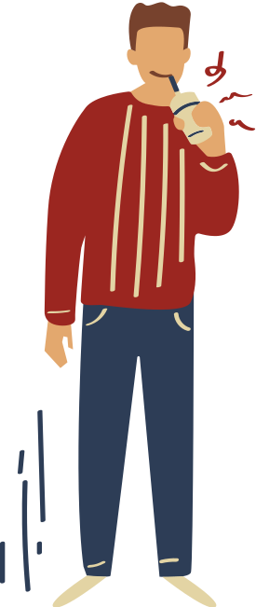
Let's talk...
ABOUT
TOXIC MASCULINITY
What do we mean by toxic masculinity?
Why is toxic masculinity harmful?
How can it be addressed?
LET'S GET TALKING ABOUT DIFFERENCE
DUALFREQUENCY.CO.UK

Slide 9
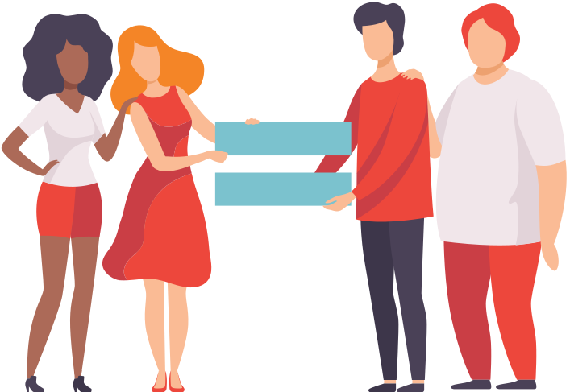
Let's talk...
ABOUT
EQUALITY AND EQUITY
What is the difference between equality and equity?
Why is equity important when talking about equality?
Ask for an example of equality vs equity in school
LET'S GET TALKING ABOUT DIFFERENCE
DUALFREQUENCY.CO.UK

Slide 10
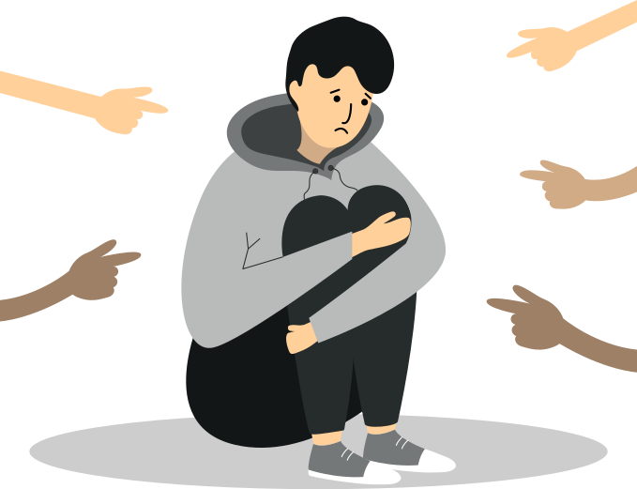
Let's talk...
ABOUT
HATE CRIME
What is a hate crime?
Why do hate crimes occur?
Where can I go to report a hate crime?
LET'S GET TALKING ABOUT DIFFERENCE
DUALFREQUENCY.CO.UK

Slide 11
Let's talk...
ABOUT
STEREOTYPES
What is a stereotype?
Why are stereotypes harmful?
How can you respond positively when you hear a stereotype??
LET'S GET TALKING ABOUT DIFFERENCE
DUALFREQUENCY.CO.UK

Slide 12
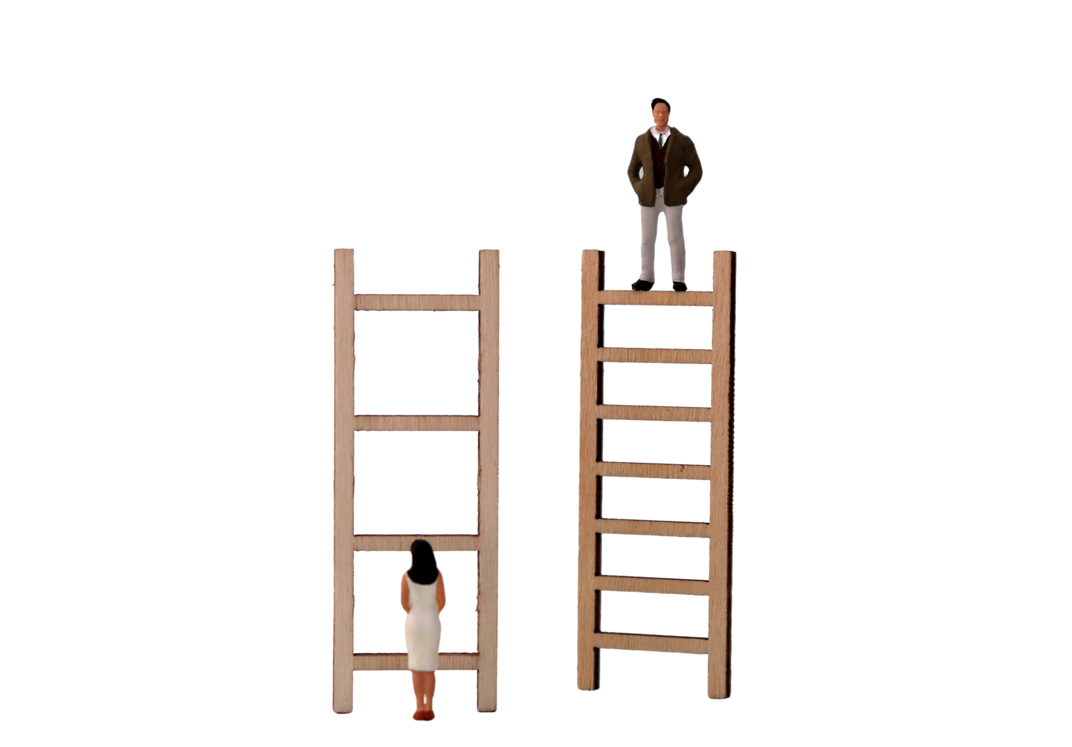
Let's talk...
ABOUT
PREJUDICE
What is prejudice?
How does it link to discrimination?
How can we safely challenge prejudiced views?
LET'S GET TALKING ABOUT DIFFERENCE
DUALFREQUENCY.CO.UK

Slide 13
Let's talk...
ABOUT
INTERSECTIONALITY
What is intersectionality?
Why do people from intersectional groups face more prejudice?
Why is it important to talk about intersections when discussing equality, diversity and inclusion?
LET'S GET TALKING ABOUT DIFFERENCE
DUALFREQUENCY.CO.UK

Slide 14
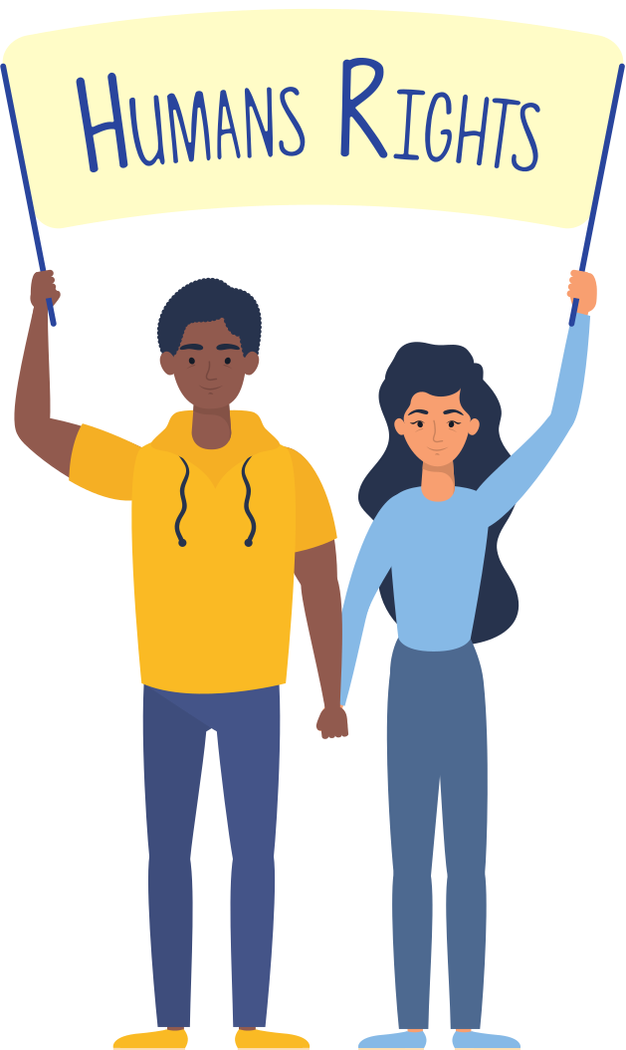
Let's talk...
ABOUT
HUMAN RIGHTS
What are human rights?
Do I have rights if I am under the age of 18?
Where can I learn more about my rights?
LET'S GET TALKING ABOUT DIFFERENCE
DUALFREQUENCY.CO.UK

